Slide 1
Introduction to the Cloud

Slide 2

Overview
What is a Server?
The Anatomy of a Datacenter
The Anatomy of the Internet
Software Stack
The Cloud
Infrastructure as a Service
Platform as a Service
Business models
Public vs. Private Cloud
Automation
Regulation

Slide 3
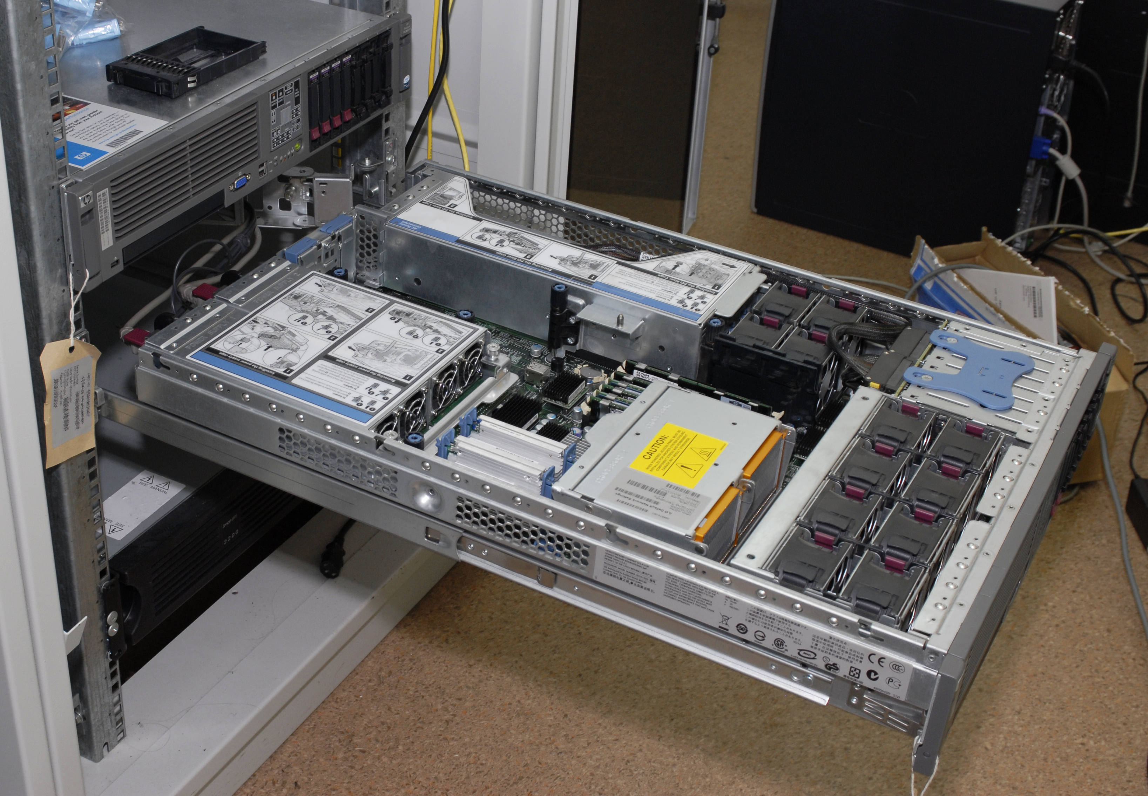
What is a Server?
Source: Wikipedia/exlex under CC BY-SA 3.0

Slide 4
CPU Architectures
SPARC
x86
X86_64
PowerPC
ARM
1986
1987
1992
1996
2003
2008
2011
2019
2020

Slide 5
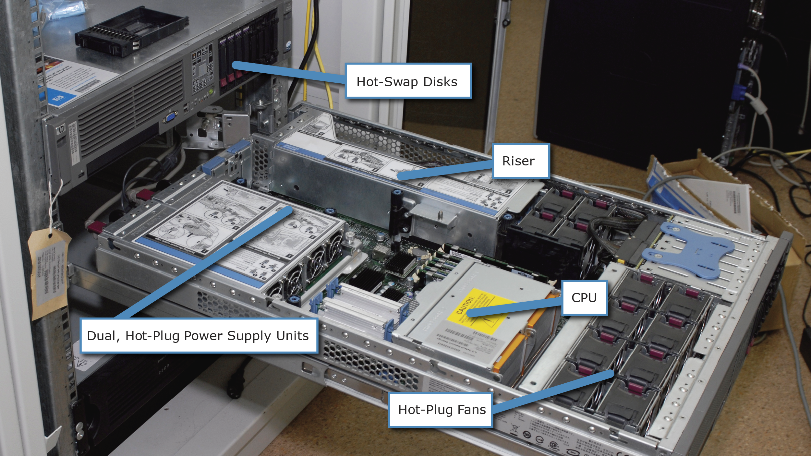
Server builds
| Source: Wikipedia/exlex under CC BY-SA 3.0

Slide 6
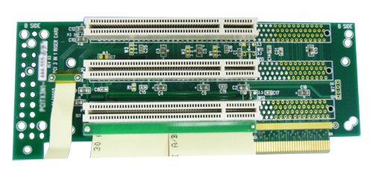
Riser
| Source: Wikipedia/Core Systems Inc. under CC0

Slide 7
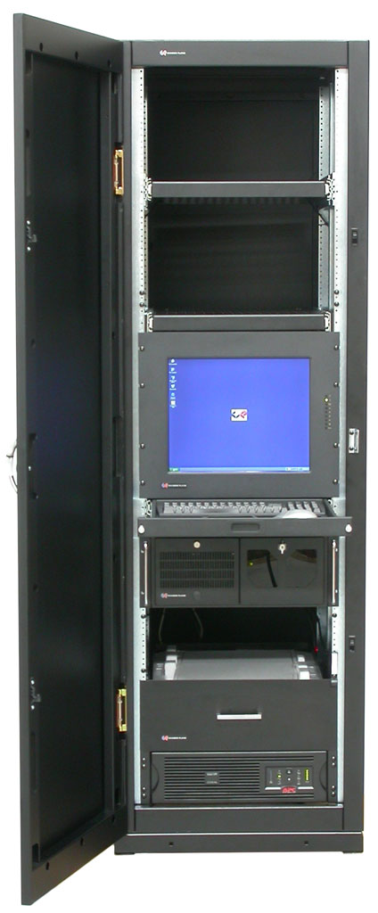
Rack
| Source: Wikipedia/David Lippincott under CC BY 3.0

Slide 8
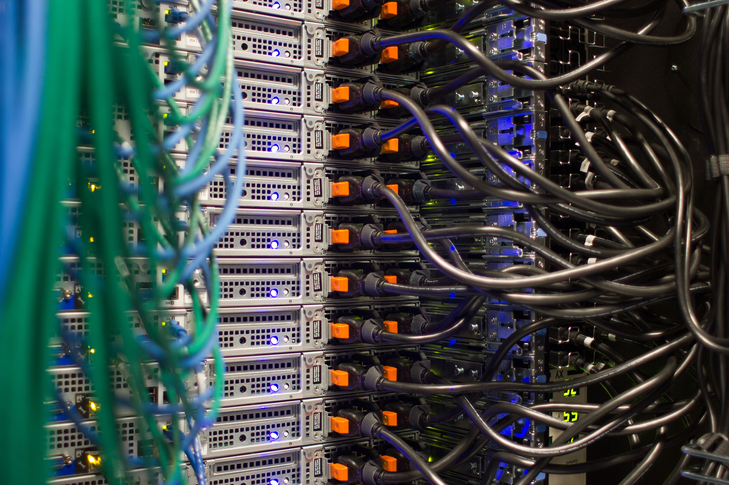
Redundant Power Supply
| Source: Wikipedia/Victor Grigas under CC BY-SA 4.0

Slide 9
Out Of Bounds Management
Public Network
Server
Out of Bounds Management
Management Network

Slide 10
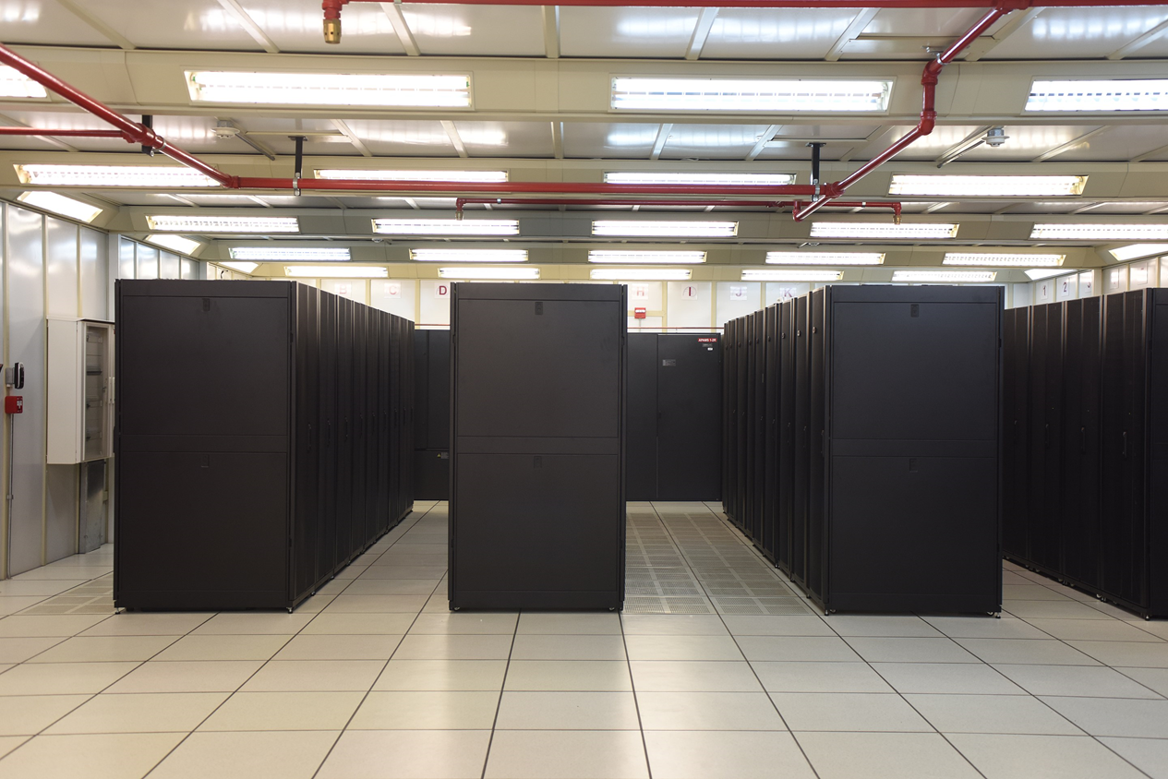
The Anatomy of a Datacenter
Source: Wikipedia/IMarcoHerrera under CC BY-SA 4.0

Slide 11
Datacenter
19” Rack
19” Rack
19” Rack
19” Rack
19” Rack
19” Rack
Fake Floor

Slide 12
Cold aisles
19” Rack
19” Rack
19” Rack
19” Rack
Fake Floor

Slide 13
Fire Suppression
Fire Suppression
19” Rack
19” Rack
19” Rack
19” Rack
19” Rack
19” Rack
Fire Suppression

Slide 14
Electric Systems
Generator
UPS
19” Rack
19” Rack
19” Rack
19” Rack
19” Rack
19” Rack
UPS
Generator

Slide 15
Network
Switch
Switch
Switch
Switch
Switch
Switch
Server
Server
Server
Server
Internet

Slide 16
Cages

Slide 17
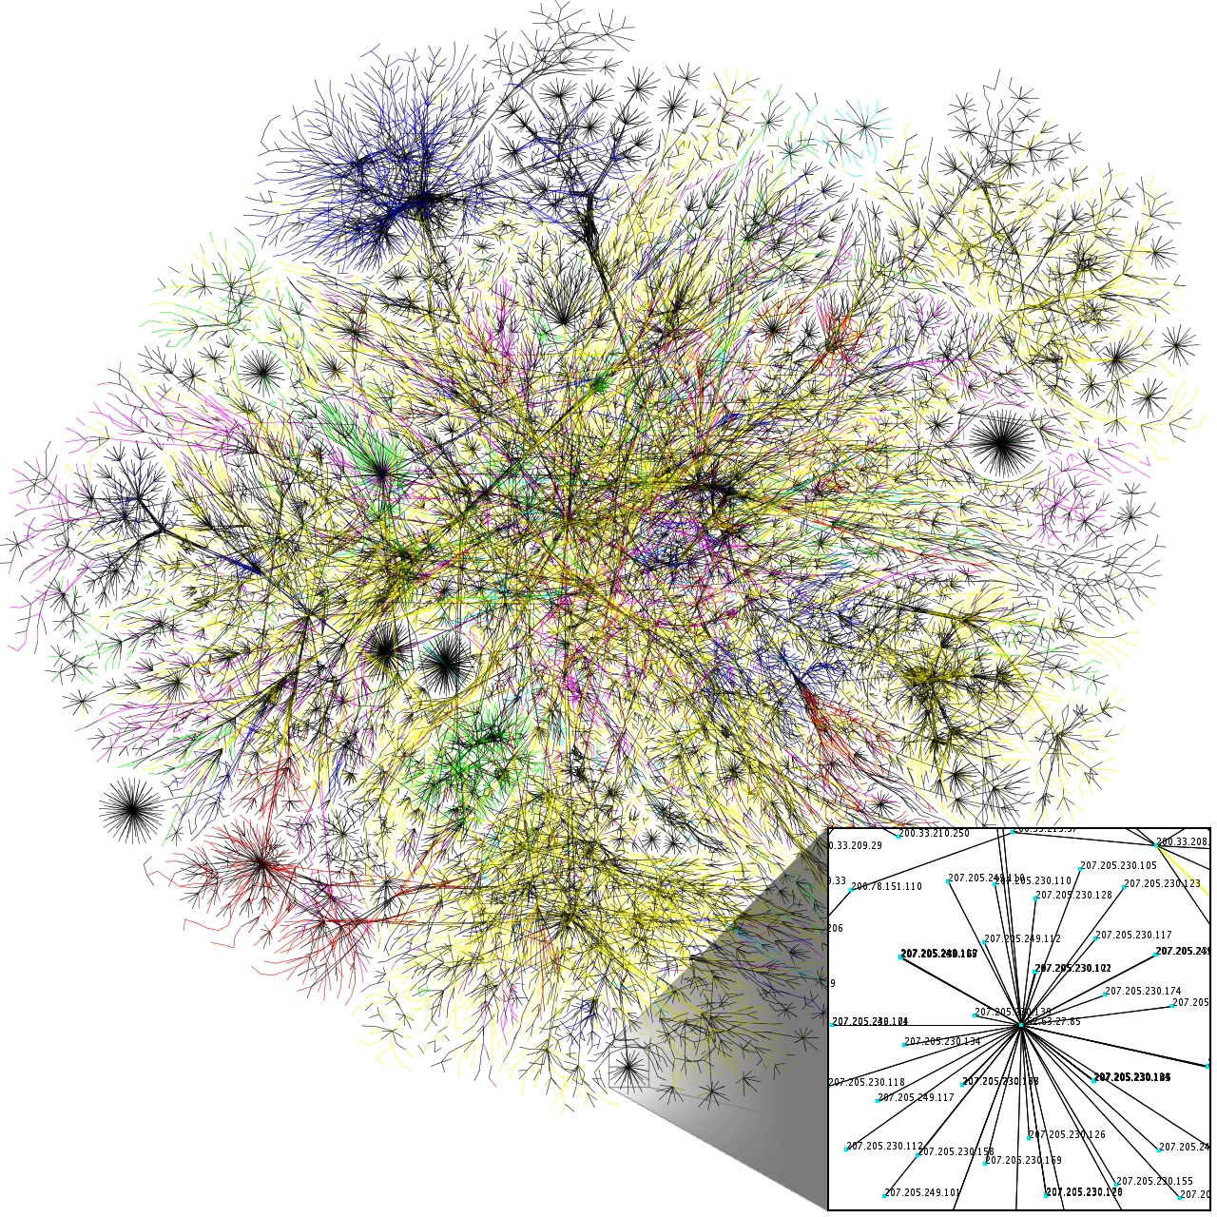
The Anatomy of the Internet
Source: Wikipedia/The Opte Project under CC BY 2.5

Slide 18
Layer 2 Network
ToR Switch
ToR Switch
ToR Switch
ToR Switch
ToR Switch
Server
Server
Server
Router
Server
Internet

Slide 19
Layer 3 Network
Your Datacenter
Other Provider
Other Provider
Router
Router
Your Internet Provider
Server
Server
Router
Internet Exchange
Server
Router
Server

Slide 20
Network Tiers
Global A
Global B
Local IX
Local A
Local B
Local C
Datacenter Customer

Slide 21

Software Stack
Source: Unsplash/Markus Spiske under the Unsplash License

Slide 22
Operating System Stack
Application
Application
OS Kernel
Hardware

Slide 23
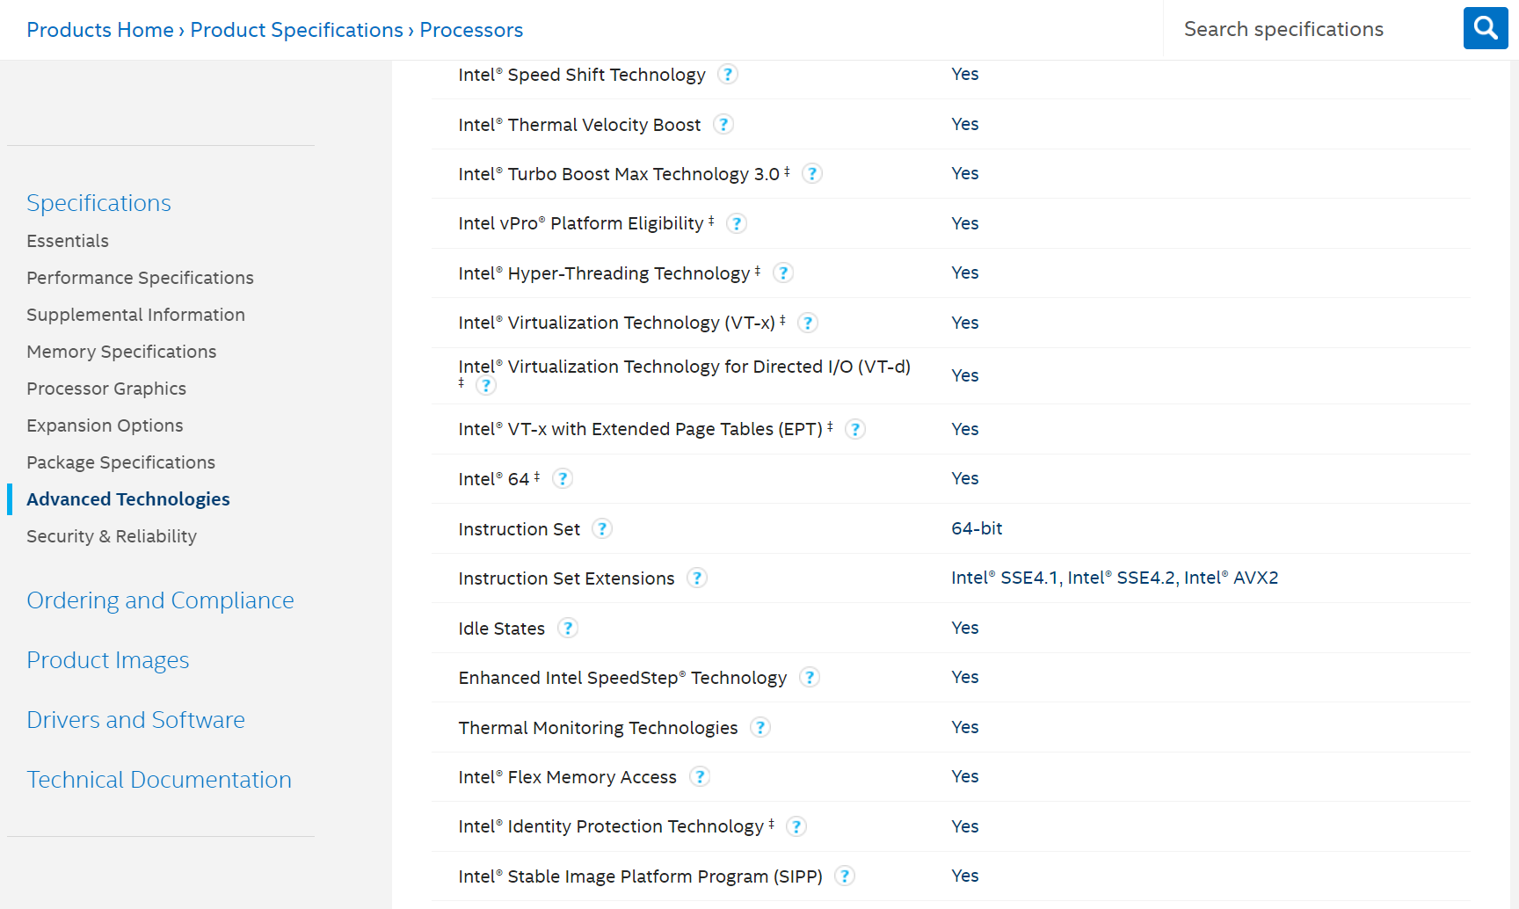
The Intel Ark

Slide 24
Virtualization vs. Containerization
Virtual Machine
Container
Application
Application
Application
Application
OS Kernel
OS Kernel
Hardware

Slide 25
Runtime Environment
Application
Runtime Environment
OS Kernel
Hardware

Slide 26
Runtime Environment
Application Javascript, Java, PHP
Runtime Environment
NodeJS, JVM, PHP Runtime
OS Kernel
Hardware

Slide 27
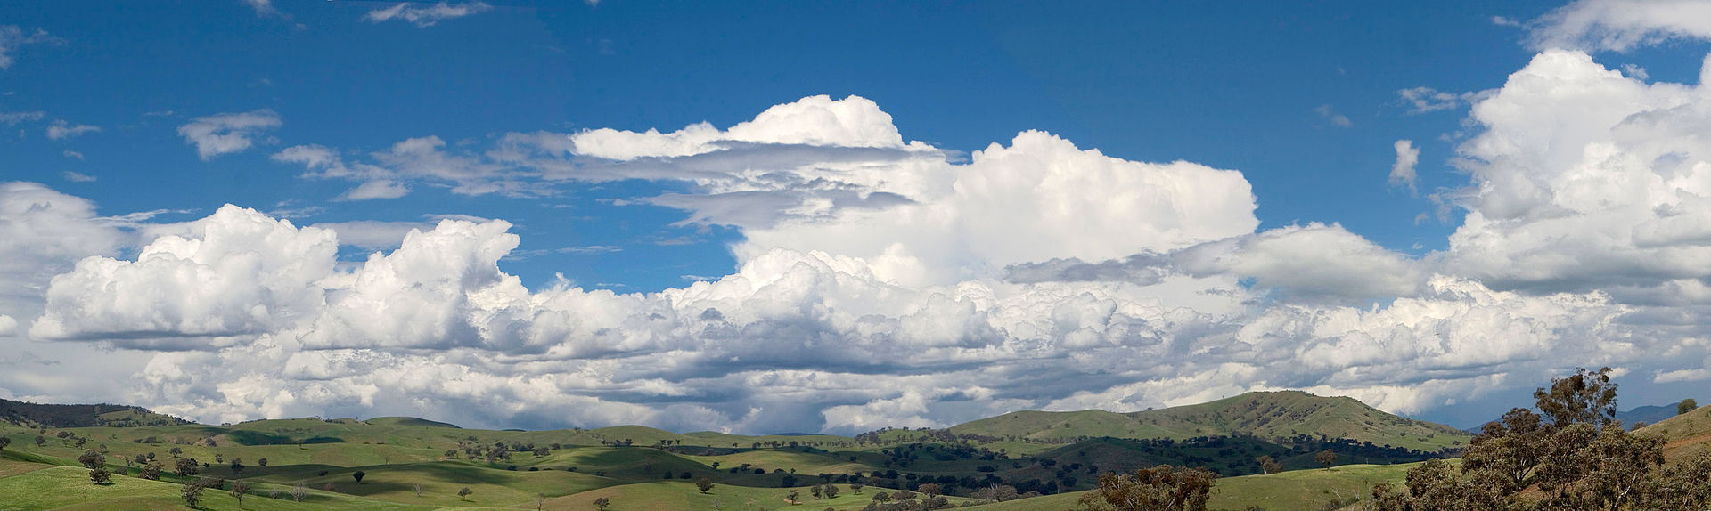
The Cloud
Source: Wikipedia/User:Fir0002 under GFDL 1.2

Slide 28

The Birth of Amazon Web Services

Slide 29

Jeff’s Letter
All teams will henceforth expose their data and functionality through service interfaces.
Teams must communicate with each other through these interfaces.
There will be no other form of interprocess communication allowed: no direct linking, no direct reads of another team’s data store, no shared-memory model, no back-doors whatsoever. The only communication allowed is via service interface calls over the network.
It doesn’t matter what technology is used. HTTP, Corba, Pubsub, custom protocols — doesn’t matter.
All service interfaces, without exception, must be designed from the ground up to be externalizable. That is to say, the team must plan and design to be able to expose the interface to developers in the outside world. No exceptions.
Anyone who doesn’t do this will be fired.
| Source: Unsplash/Kelly Sikkema under the Unsplash License

Slide 30


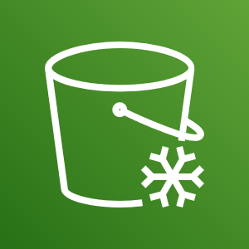
The Birth of Amazon Web Services
SQS
EC2
S3

Slide 31
Cloud Flexibility
Change
Cloud Infrastructure
Provide
Cloud API
Management Application
Observe

Slide 32
What is a cloud? (NIST)
Cloud computing is a model for enabling ubiquitous, convenient, on-demand network access to a shared pool of configurable computing resources (e.g., networks, servers, storage, applications, and services) that can be rapidly provisioned and released with minimal management effort or service provider interaction.

Slide 33
What makes a cloud? (NIST)
On-demand self-service,
Broad network access,
Resource pooling,
Rapid elasticity,
Measured service.

Slide 34
Cloud Categories
Self-managed
IaaS
Self-managed
Self-managed
Application
Application
Application
Application
Runtime
Runtime
Runtime
Runtime
Customer Manages
Provider Manages
Operating System
Operating System
Operating System
Operating System
Virtualization
Virtualization
Virtualization
Virtualization
Hardware
Hardware
Hardware
Hardware
Network
Network
Network
Network
Power
Power
Power
Power
Cooling
Cooling
Cooling
Cooling
Fire suppression
Fire suppression
Fire suppression
Fire suppression
Housing
Housing
Housing
Housing

Slide 35
Infrastructure as a Service
Source: Wikipedia/User:Fir0002 under GFDL 1.2

Slide 36
Platform as a Service
Source: Wikipedia/User:Fir0002 under GFDL 1.2

Slide 37
Business Models
Source: Wikipedia/User:Fir0002 under GFDL 1.2

Slide 38
Private vs. Public Cloud
Source: Wikipedia/User:Fir0002 under GFDL 1.2

Slide 39
Automation
Source: Wikipedia/User:Fir0002 under GFDL 1.2

Slide 40
Regulation
Source: Wikipedia/User:Fir0002 under GFDL 1.2

